Slide 1




The Language of Food
How do we leverage user feedback to improve dining experiences?
By Schubert Laforest
Notes:
https://public.tableau.com/profile/schubert.h.laforest#!/vizhome/YelpBusinessVisualizations/DashboardMapandBar

Slide 2

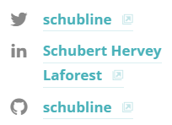



Schubert Hervey Laforest Recent Data Science Immersive Grad, General Assembly B.A. Linguistics, Political Science & Marketing, Concordia University I live at the intersection of data, social science and the internet.
Some Places I’ve Worked at

Slide 3
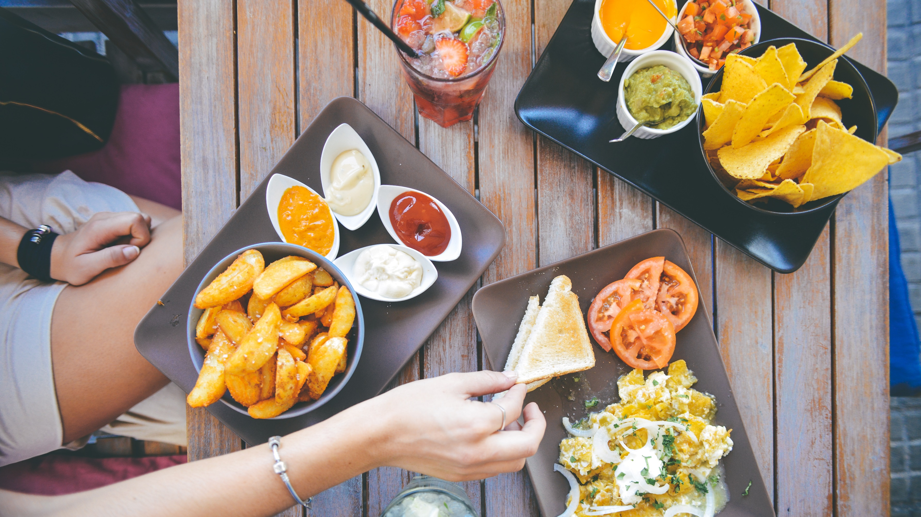
Food is Important to Us

Slide 4
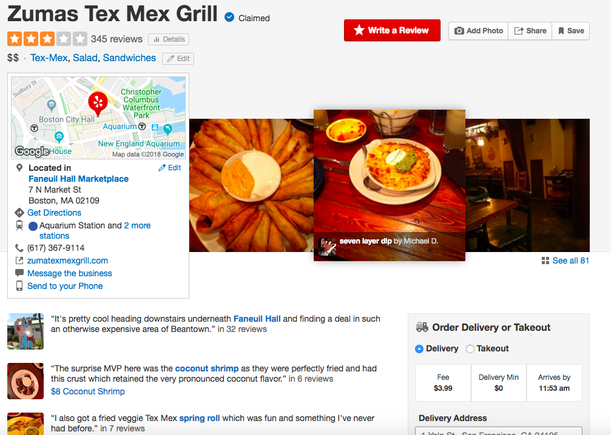
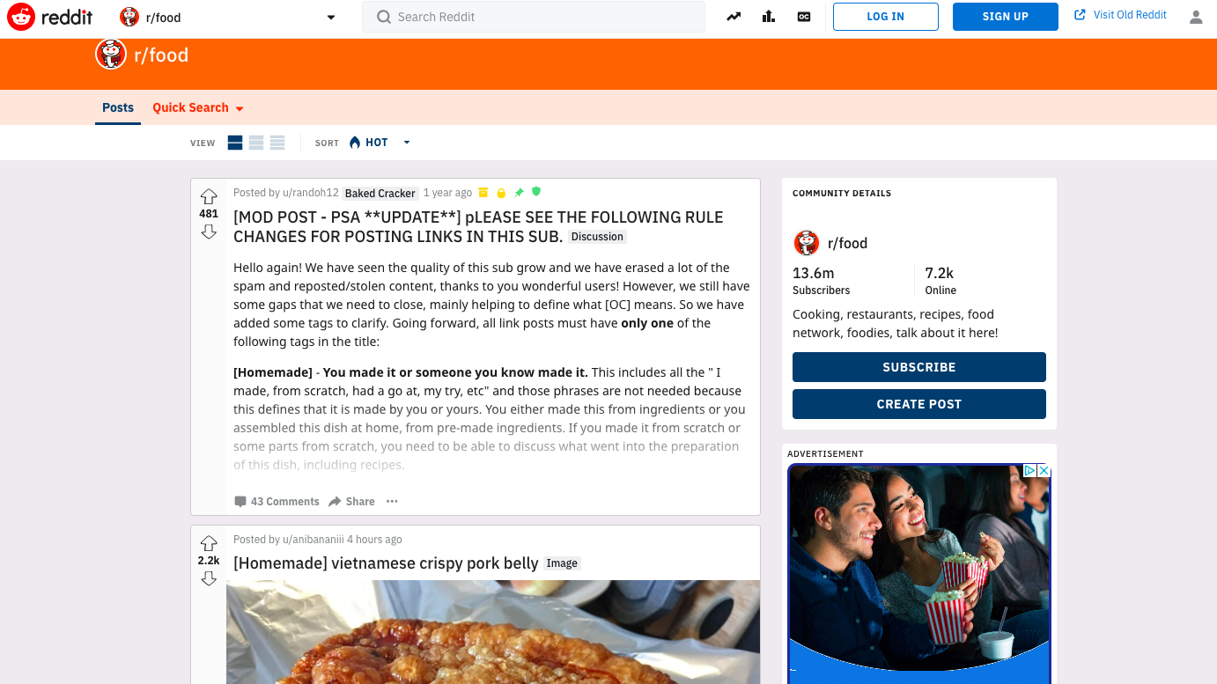
We don’t just eat food, we like to talk about it, a lot…

Slide 5
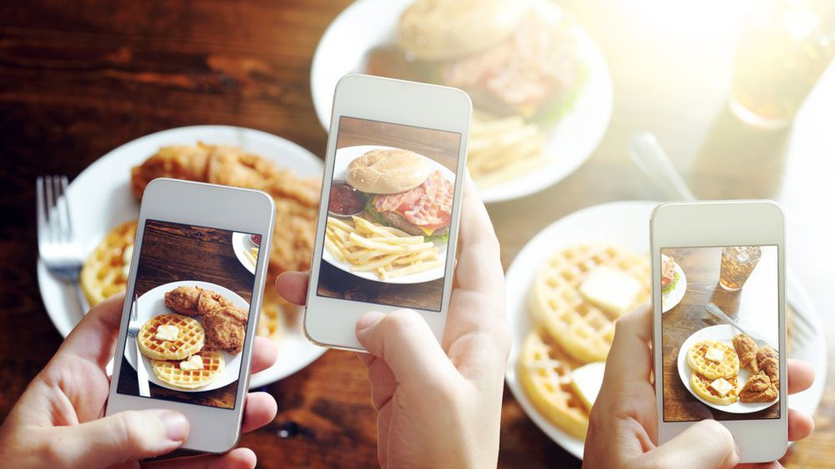
We Take Pictures of Food, a Lot …

Slide 6

And Watch Shows About It, a Lot…

Slide 7

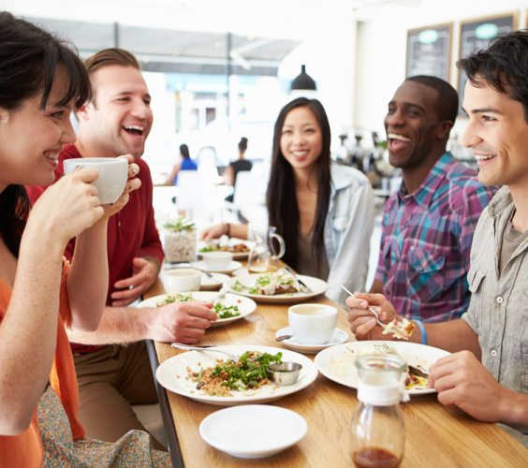

How Do We Improve Dining Experiences?
For Customers
Think about your Best and Worst dining experiences

Slide 8
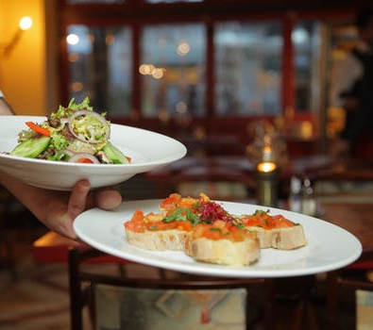
How Do We Improve Dining Experiences?
For Businesses

Slide 9

Data!!!
(and a lot of science)

Slide 10
Turning the Business Question into a Data Question
Business Question: How do we leverage user feedback to improve dining experiences?
Data Question: How can we use Recommender Systems and Natural Language Processing to improve dining experiences?
Replicating a grandmother’s intuition and Gordon Ramsay’s business acumen.

Slide 11
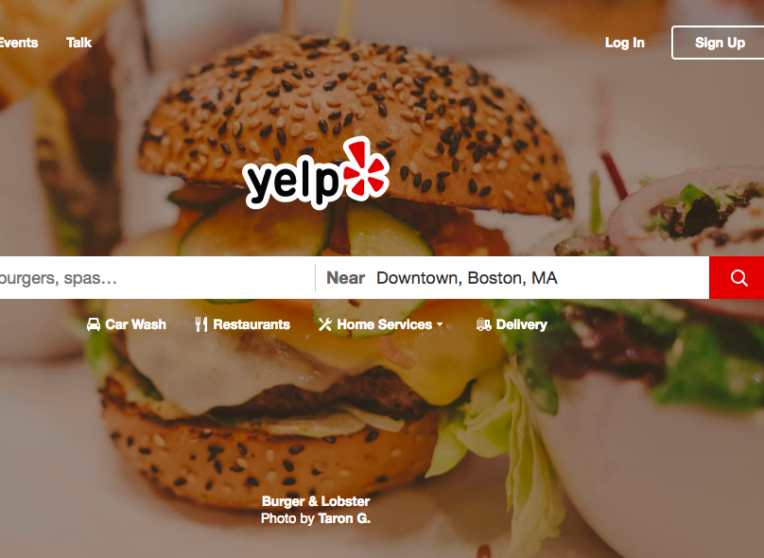
Quick Facts on Yelp Dataset (Kaggle)
“Small” subset of Yelp Reviews
5,2000,000 user reviews
Information on 174,000 businesses
Spans 11 metropolitan areas.
Stat: A one-star increase in Yelp rating leads to a 5-9 percent increase in revenue

Slide 12
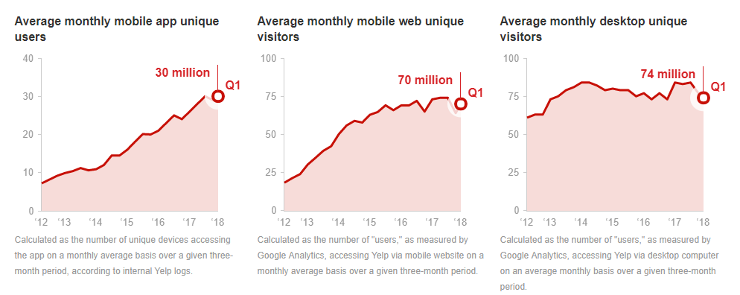
“ 82% of adults consult online reviews before buying something for the first time, 40% always do ” - Fernbach et. all

Slide 13
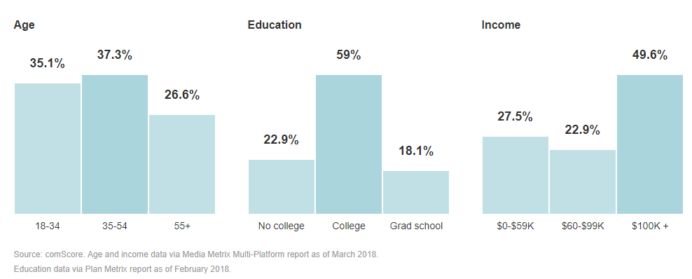
US Yelp User Demographics

Slide 14

How Do We Make Sense of All This Data and Solve our Business Question?
Exploratory Data Analysis
Build a baseline Recommender System
Dive into the language of reviews
Try some creative approaches
Hosting Data on AWS

Slide 15
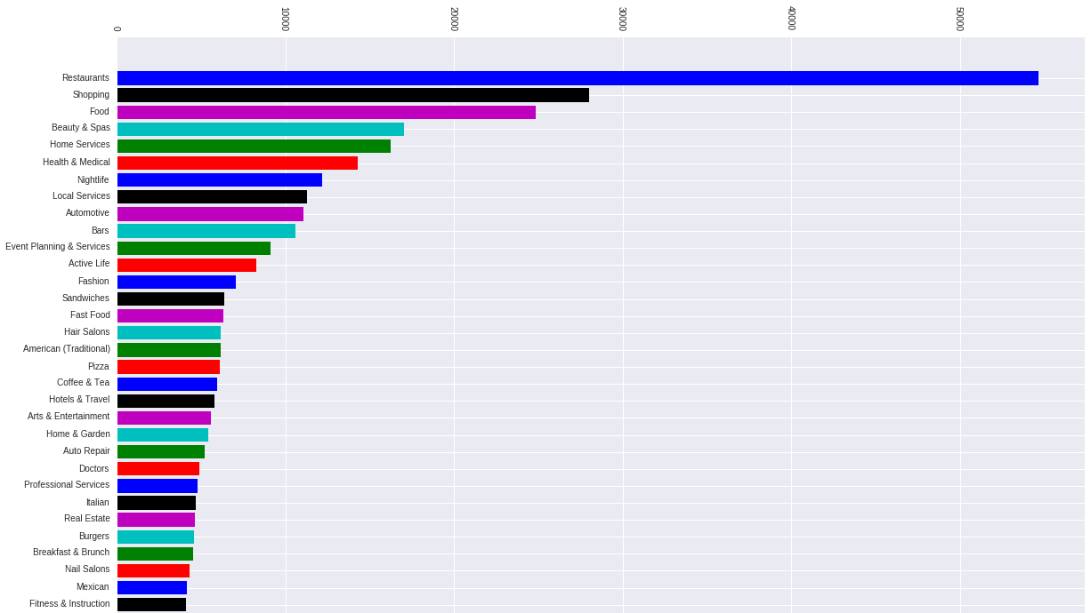
Review Count by Category

Slide 16
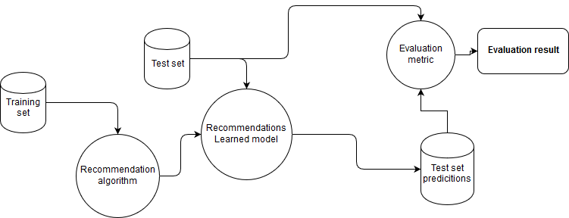
Process of Building a Recommender System
Notes:
Steps
Get the columns you need: Business name, user_id, raitings
Create a pivot table: need an index of all users, and single column for every restaurant
Make a sparse matrix from the pivot table (matrix in which most of the elements are 0)
Calculate the cosine similarity (take two non-0 vectors and calculate the cosine of the angle between them

Slide 17

Recommender Based on Star Ratings
Built on a subsection of our Data
Star-Ratings = Explicit Data
Item-Based Recommender: Basically, it suggests similar restaurants

Slide 18

That’s Kinda cool!
But what are the possible the shortcomings of this approach?

Slide 19
“ A model is a simplification of reality” – Matt Brems
Every person has their own mental model of how they choose and subsequently evaluate what and where they want to eat
We all have different palates and preferences.
Small sample size
Heavily skewed data and lopsided databases
Can we build a better recommender based off of review text?

Slide 20
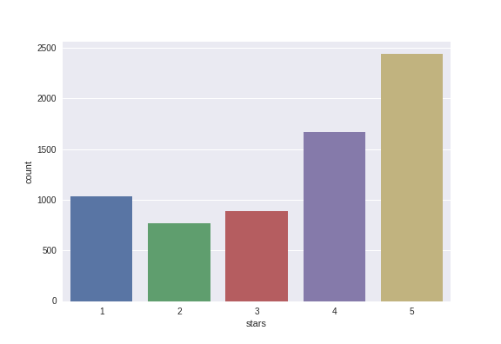
Distribution of Star Score
Notes:
Some business try to combat this by subjecting users to a non-disparagement clause. Basically, if a consumer wants to do business with an establishment, they have to agree not to talk negatively about them online. These can be problematic for several reasons:
- Hidden deep in Terms of Service Agreements and not readily made available.
- Only targets negative reviews, information that can actually be helpful to other users, creating a "lopsided database"
- Unfair advantage for Business that have these clauses, since most of their reviews will be positive

Slide 21
A Closer Look at Review Text
'First time great food and service will be going back had the hot dogs more food than 1 person can eat'
'Slow service every time, and food has been cold twice. Poorly managed version of this chain. The Rock Hill location is fantastic!'

Slide 22
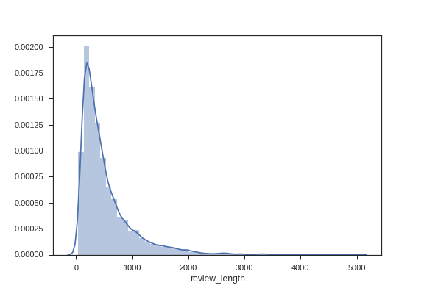
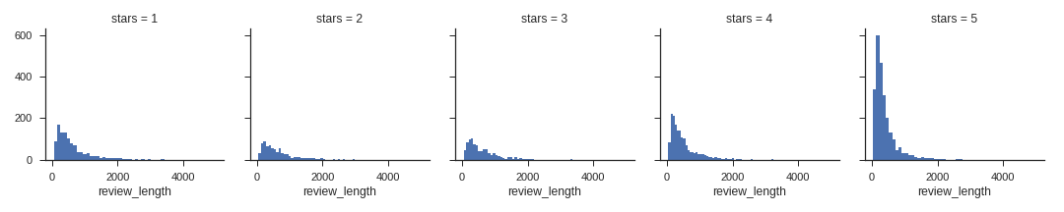
Review Length
Review Length by Star Rating

Slide 23
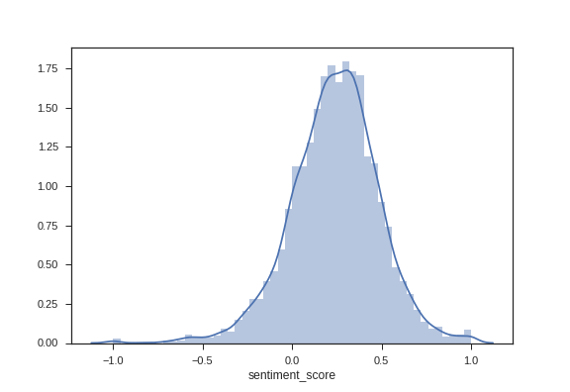
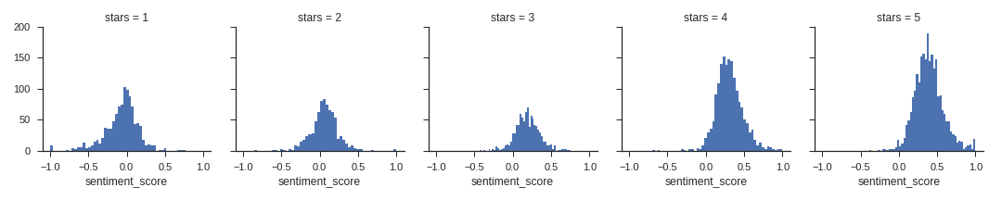
Distribution of Sentiment Score
Sentiment by Star Rating
Notes:
How sentiment Score is calculated
TextBlob's NaiveBayesAnalyzer is apparently based on the Stanford NLTK. The analysis returns two values: polarity and subjectivity. The polarity score is a float within the range [-1.0, 1.0] where 0 indicates neutral, +1 a very positive attitude and -1 a very negative attitude.
In my project, I was was decided to focus on polarity as that was the implicit user data I wanted to a certain and build a recsys on

Slide 24
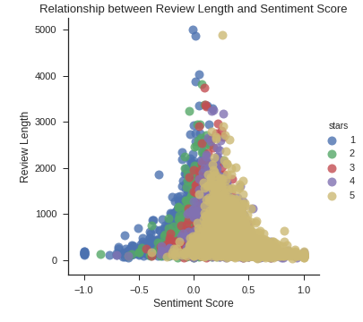
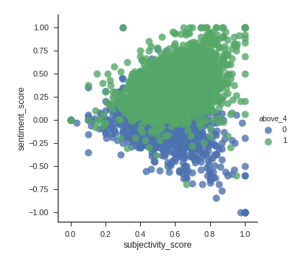

Slide 25
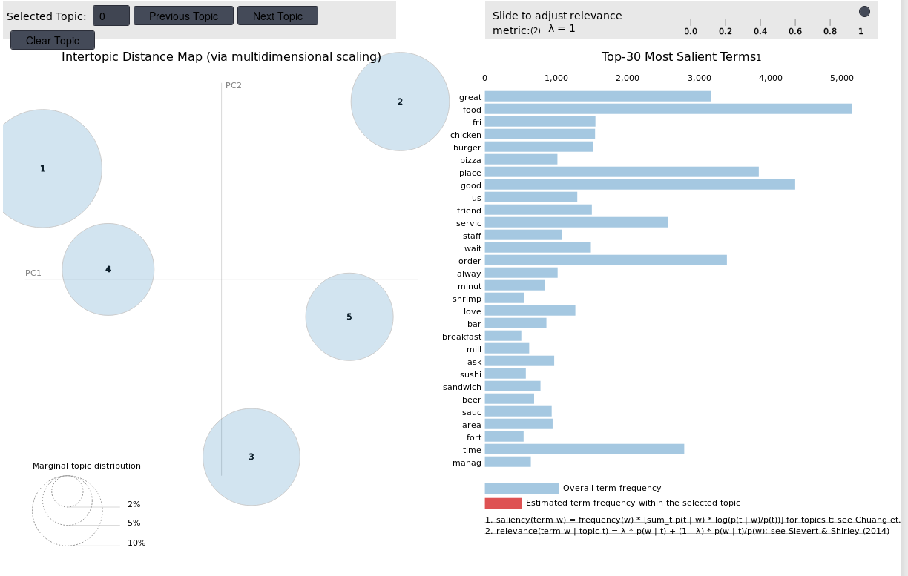
Visualizing Latent Dirichlet Allocation (LDA)
Notes:
Definition of LDA
Topic Modeling is a form of unsupervised learning, where the goal is to use a statistical model to attempt to identify topics or categories in a set of documents. One specific method of topic modeling is known as Latent Dirichlet Allocation (LDA, not to be confused with Linear Discriminant Analysis)
Select a fixed number of topics
Radomly assigns a word to each Topic (this is for initialization purposes and has no inherent meaning at this point, hence random)
For each document d, word w and topic t, using Bayes' theorem we calculate $$ P(t|w,d) $$
We keep doing this process until we reach "convergence", defined as arriving at the optimal number of word assignment to topics.

Slide 26
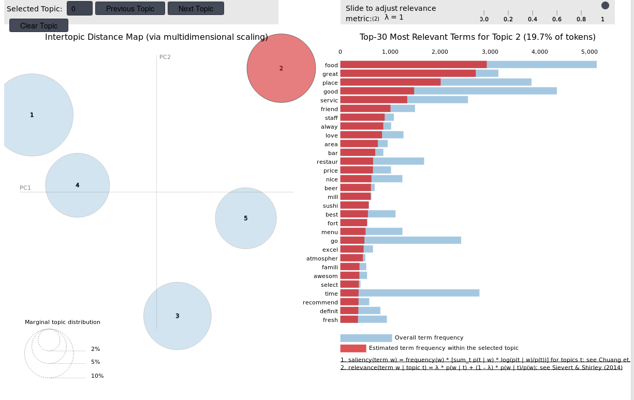
Visualizing Latent Dirichlet Allocation (LDA)
Notes:
Why LDA
Chose LDA because, in this case, I believe it was more appropriate to view the number of topics as a proportion of cluster membership. Using LDA would enable me to "soft" cluster the composite parts. This is more preferable to k-means where each element can only be a member of one cluster. I plain English, I wanted to have the same words be able to contribute to different topics instead of having them just contributing to one. This approach is more nuanced.

Slide 27
Recurring Themes in Reviews
Five Star Reviews
One Star Reviews
“Great Ambiance”
“Amazing Experience”
“Nice Servers”
Common Words: “Love, cheap, great, excellent”
“Slow Service”
“Worst customer service”
“Absolute Garbage”
Common Words: “Terrible, disappointed, horrible”

Slide 28
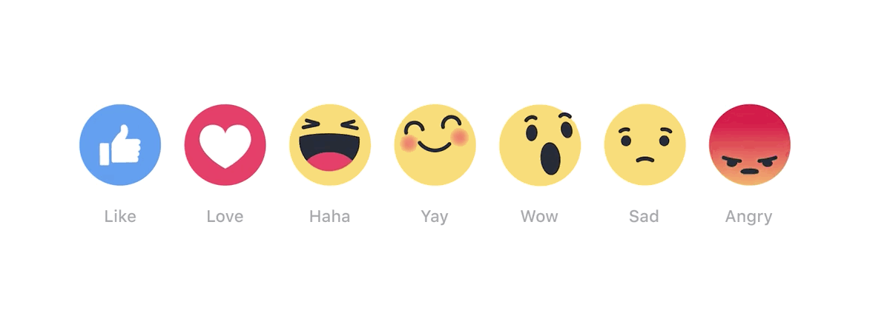
A Different Kind of Recommender
Using sentiment instead of ratings

Slide 29
So, which is better?
Recommendation based on Ratings
or
Recommendations based on Sentiment

Slide 30
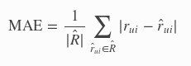
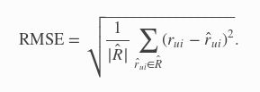
Preliminary Results
Star-Based Recommender
Scale [1, 5]
Sentiment-Based Recommender
Scale [-1, 1]
RMSE: 1.05
MAE: 1.26
RMSE: 0.784
MAE: 0.748

Slide 31
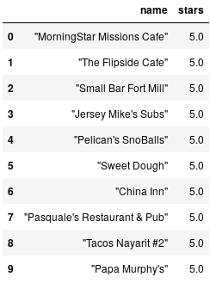
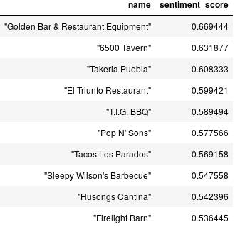
Popularity Models
Star Based Ranking
Sentiment Based Ranking

Slide 32
Recap
Exploratory Data Analysis
Build a baseline Recommender System
Dive into the language of reviews
Try some creative approaches

Slide 33
Next Steps
This framework is deployable and can be A/B tested. It can be scaled, it can be tuned.
Evaluating the effectiveness of each Recommender system by pulling live data from Yelp’s API
Network Analysis on Reviewers and Elite Reviewers
Technical:
Different Recommenders Based on interaction thresholds (Popularity → Hybrid Collaborative Filtering)
Continue to tune models with more feature engineering
More Grid-searching on Single-Value Decomposition (SVD) models for better scores (RMSE, MAE of projected ratings), or HIT - How many recommendations are necessary to use collaborative filtering for new users
Identify preferences vs dislikes

Slide 34
Thank You!
“While the individual person is an insoluble puzzle, in the aggregate they becomes a mathematical certainty. You can, for example, never foretell what any one person will do, but you can say with precision what an average number will be up to. Individuals vary, but the percentages remain constant. So says the statistician.” – Sherlock Holmes

